Slide 1

MANIPAL UNIVERSITY JAIPUR
Department of Computer and Communications Engineering
TEAM NAME
NULL
TEAM ID
U5R4QDJ7
PROBLEM STATEMENT ID
PROBLEM STATEMENT TITLE
Voice Clone Detection for Phone scams
THEME / DOMAIN
36-HOUR HACKATHON • 24–25 OCTOBER 2026
Audio Forensics
BUILD / INNOVATE / CREATE
CATEGORY
Software
hypnexismuj.com | @hypnexis.muj | hypnexis2026@muj.manipal.edu

Slide 2
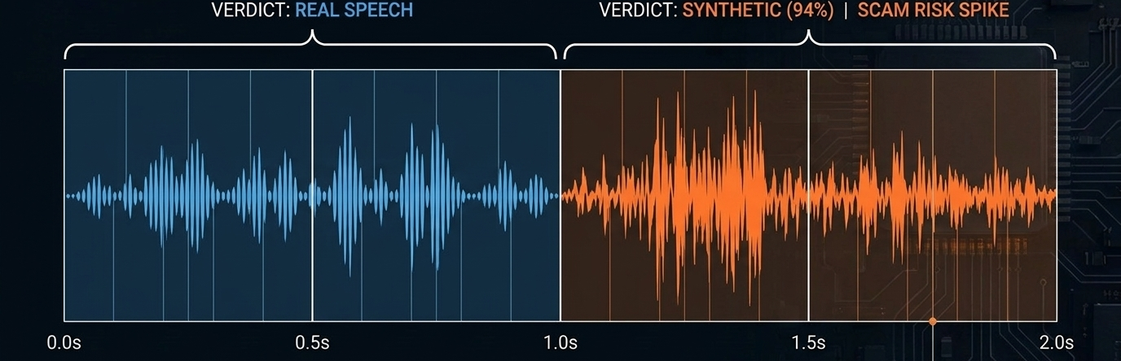
VOICESHIELD: LIVE VOICE DEFENSE
NULL | U5R4QDJ7
PROBLEM STATEMENT
OUR SOLUTION
AI voice clones now bypass voice authentication, support lines and executive approvals.
Banks, call centers, enterprises, and seniors and families targeted by vishing are hit hardest.
Legacy forensics relies on static, post-call file uploads and returns only a binary real/fake verdict.
Attacks happen live, so a verdict that arrives after the call is too late.
VoiceShield analyzes live mic or streamed audio over WebSocket in real time.
It localizes fake audio to exact 0.5 s segments with per-segment spoof scores.
It outputs a verdict, confidence, acoustic biomarkers and a dynamic scam-risk score.

Slide 3
TECHNICAL APPROACH
NULL | U5R4QDJ7
SYSTEM ARCHITECTURE
CORE TECHNOLOGIES
Capture: MediaRecorder / Web Audio API in the browser
Stream: React frontend (api.ts) sends audio over WebSocket /ws/stream
Process: FastAPI backend and audio pipeline extract acoustic features (pitch jitter, spectral flux)
Analyze: anti-spoofing model returns verdict, scam risk and 0.5 s segment scores
Neutralize: live dashboard updates with a real-time risk meter
Python 3.12+, FastAPI, TypeScript, React, Vite, Tailwind CSS
Runs on GPU; optional CPU with Torch, Torchaudio, Transformers
REST + WebSocket APIs with Swagger UI (/docs)
UNIQUE POINTS
Live WebSocket streaming, not static file checks
Pinpoints fake audio to exact 0.5 s segments
Scam-risk score beyond a binary real/fake verdict
Runs on CPU with a safe fallback; GPU optional

Slide 4
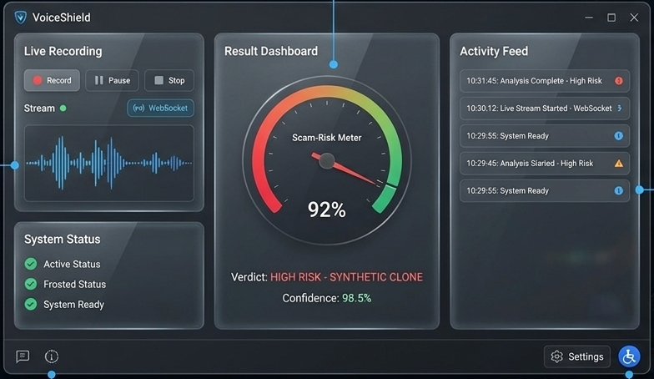
USER EXPERIENCE & DESIGN
NULL | U5R4QDJ7
USER INTERFACE
USER FLOW
DESIGN GOAL
Live Recording panel: record, pause, stop, stream over WebSocket
Result Dashboard: verdict, confidence score and scam-risk meter
Activity Feed: immutable, timestamped logs of past analyses
Accessibility: keyboard navigable, high contrast, responsive
1
Record live or stream an audio file
One glance tells you if a voice is real, how sure we are, and how risky the call is.
2
Stream, extract features, score 0.5 s segments
3
Dashboard shows verdict, confidence, scam risk

Slide 5
FEASIBILITY AND VIABILITY
NULL | U5R4QDJ7
TECHNICAL FEASIBILITY
ECONOMIC FEASIBILITY
OPERATIONAL VIABILITY
Stack is ready: FastAPI backend and Vite + React frontend start in two commands
Needs Node 20+ and Python 3.12+; no GPU required
Modular code: API routes, audio pipeline, feature extraction and model are separate
Torch-based model is optional; a safe stub fallback keeps the server up
Prototype cost is minimal: open-source stack that runs on CPU
Scaling cost grows with GPU compute and API call volume
Revenue: tiered SaaS API, then enterprise licensing
Static UI can be served from a CDN
Deployed as a FastAPI service with a static React UI
Risk: CPU fallback is less accurate than the full model
Fix: enable the Torch model where GPUs are available
Risk: clone quality keeps evolving; benchmark scripts support re-testing

Slide 6
IMPACT AND BENEFITS
NULL | U5R4QDJ7
1
SOCIAL IMPACT
2
ENVIRONMENTAL IMPACT
Stops voice-scam fraud and protects seniors and businesses
Restores trust in digital support lines
Software-only, CPU-friendly architecture
Replaces costly, energy-heavy forensic labs
3
TECHNICAL IMPACT
4
EDUCATIONAL IMPACT
Live WebSocket analysis with 0.5 s segment localization
Open, modular code
Open toolkit that teaches audio biomarkers
Hands-on AI security demos via Swagger (/docs)

Slide 7
BUSINESS MODEL & SUSTAINABILITY
NULL | U5R4QDJ7
TARGET USERS
REVENUE & COST MODEL
SUSTAINABILITY
Primary: banks and call centers
Partners: telecom and fintech authentication platforms
Early adopters: fraud units, verification teams, newsrooms, privacy-minded individuals
Phase 1: free open-source prototype on GitHub to validate accuracy
Phase 2: pilot SaaS API, tiered by API call volume
Phase 3: enterprise licensing with on-premise installs, API SLAs and dedicated instances
Partnerships with telecom and fintech platforms
Expansion: multilingual audio and mobile SDK integrations
Open-source community builds trust and transparency

Slide 8
RESEARCH AND REFERENCES
NULL | U5R4QDJ7
KEY TECH & RESEARCH SOURCES
Project repository: github.com/sumitsingh6359069/ai-voice-clone
Core stack documentation: FastAPI, React, Vite, Tailwind CSS, TypeScript
Optional ML libraries: PyTorch, Torchaudio, Hugging Face Transformers
Acoustic biomarkers used for detection: pitch jitter, spectral flux, per-0.5 s spoof scores
Existing solutions studied: legacy batch forensics (static upload, binary real/fake verdict)

Slide 9
THANK YOU
NULL | U5R4QDJ7
CREATE / AN / IMPACT

